Slide 1
Lists Part 2
Notes:
In this lesson we’re going to talk about one of the most important data types in python: Strings.

Slide 2
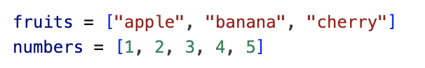
Lists
Sometimes we need to deal with multiple items at once (e.g., a shopping basket, grades, names)
In these cases we can use a container such as lists
Python lists are written using square brackets []
Python lists can contain mixed data types.
mixed = ["hello", 3.14, True, 42]

Slide 3
Lists
Finding the length (i.e., number of items) of a list
guests = ["Alice", "Bob", "Charlie"]
len(guests) # 3

Slide 4
Lists
Accessing elements by index.
Python uses a zero-based indexing (the first element is the one of index 0).
The last element of a list with n elements is the one of position n - 1
Negative items count from the end
fruits = ["apple", "banana", "cherry"]
fruits[0] # Output: apple
fruits[1] # Output: banana
fruits[2] # Output: cherry
fruits[-1] # Output: cherry
fruits[-2] # Output: banana
fruits[-3] # Output: apple

Slide 5
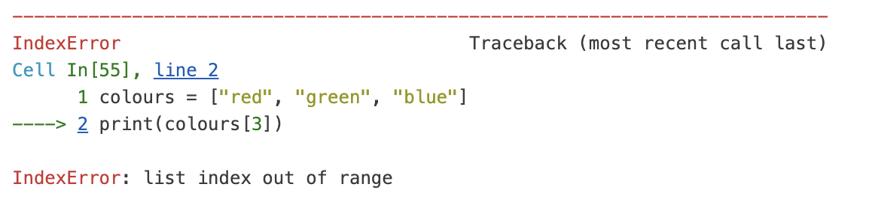
Lists
Avoiding index errors.
Python will throw an IndexError if you try to access an element that doesn’t exist.
colours = ["red", "green", "blue"]
colours[3]

Slide 6
Lists
Lists are mutable
We can change it after it is created.
fruits = ["apple", "banana", "cherry"]
fruits[1] = "blueberry"
fruits # Output: ['apple', 'blueberry', 'cherry']

Slide 7
Adding elements to a list
There are different ways in which you can add elements to a Python list.
.append() → adds an element to the end of a list.
.insert() → adds an element at a specific index.
fruits.append("orange")
fruits # ['apple', 'blueberry', 'cherry', 'orange']
fruits.insert(1, "mango")
fruits # ['apple', 'mango', 'blueberry', 'cherry', 'orange']

Slide 8
Removing elements from a list
There are different ways in which you can remove elements from a Python list.
del → remove a specific item.
.pop() → remove by index and returns the value.
.remove() → remove by value (first occurrence)
fruits = ['apple', 'mango', 'blueberry', 'cherry', 'orange']
del fruits[0]
fruits # ['mango', 'blueberry', 'cherry', 'orange']
first = fruits.pop(0) # removes first item
first # 'mango'
last = fruits.pop() # removes last item
last # 'orange'
fruits.remove("cherry")
fruits # ['blueberry']

Slide 9
Sorting lists
Python gives us tools to sort, reverse, and measure lists.
The .sort() method arranges the list in order and changes the original list.
Sorting in reverse order:
squares = [9, 4, 16, 81, 64]
squares.sort()
squares # Output: [4, 9, 16, 64, 81]
squares.sort(reverse=True)
squares # Output: [81, 64, 16, 9, 4]

Slide 10
Sorting lists
The sorted() function leaves the original list unchanged, and instead returns a new, sorted list.
squares = [9, 4, 16, 81, 64]
sorted_squares = sorted(squares)
print(sorted_squares) # Output: [4, 9, 16, 64, 81]
print(squares) # Original list remains unchanged: [9, 4, 16, 81, 64]

Slide 11
Sorting lists
Sorting a list of strings
By default, Python sorts strings in alphabetical order.
Notice that it is case-sensitive:
capital letters come before lowercase ones because of their ASCII values.
fruits = ["banana", "apple", "date","cherry"]
fruits.sort()
print(fruits) # ['apple', 'banana', 'cherry', 'date']
cars = ["BMW", "audi", "Toyota", "subaru"]
print(sorted(cars)) # ['BMW', 'Toyota','audi', 'subaru']

